Slide 1
BANDWIDTH ON DEMAND AS A NETWORK SERVICE

Slide 2
Objective
To develop a sdn application to set the bandwidth requested by the user
To use opendaylight architecture and its APIs in devloping this application
To develop an UI for taking input from the user (Bandwidth).
To find hosts mac address and its immediate switch details.
Use north bound api to connect to ovsdb on mininet and modify the Port table, qos table and the queue table.
Use restconf api to set flows.
Verify the results using iperf tool.

Slide 3
ON DEMAND BANDWIDTH
It is a network connectivity service that allows users to request bandwidth at desired levels when and where they need it.
Currently connectivity services are static: once the endpoints and service attributes are defined no changes are done to the service.
Any change to the service requires manual intervention and is time consuming procedure.
Need for highly adaptable service which changes as per the demand of the user.

Slide 4
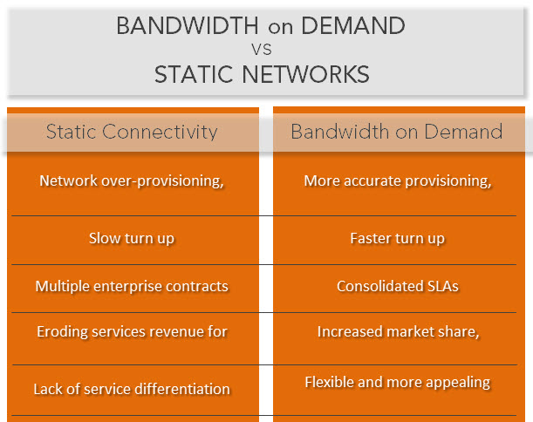

Slide 5
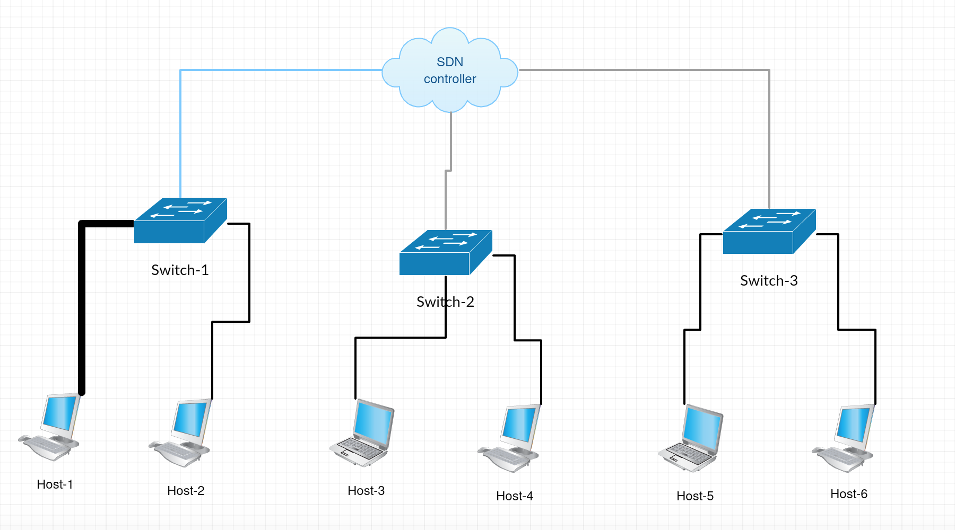
Overview of our application

Slide 6
ARCHITECTURE
ODL Components Used
OVSDB
Restconf Api
Northbound Api
OVSDB
OVS Databse is on mininet VM and its common to all the switches.
We can connect to this OVSDB in two ways:
Active mode: ODL initially connects to OVSDB and after that it will listen to changes on OVSDB.
Passive mode: OVSDB will listen for changes from ODL. We are making use of this mode.

Slide 7
In OVSDB we use following tables
Port Table:
This table has details of all the interface which connect to corresponding hosts and each interface is associated with Qos foreign key(UUID of QoS table). Each tuple is uniquely identified by UUID.
Qos Table:
This table contains Quality of Service (QoS) configuration for each Port that references it. Each row is identified by UUID and is mapped to several Queue in Queue table.
Queue Table
This table contains a configuration for a port output queue, used in configuring Quality of Service (QoS) features. We can set max_rate and min_rate using Other-config column.
We used max_rate to set the maximum bandwidth which user request and min_rate to some predefined value.

Slide 8
Restconf Api
We Used this Api to set flows.
While setting the flow we define set queue in the action to the queue number in QoS Table.
Set_queue is always zero because we have only one queue associated with each port.
Northbound Api
Northbound Apis are used to access OVSDB on mininet.

Slide 9
FLOW DIAGRAM
FLOW CHART
Start
Get Bandwidth and Host Mac from User
Create QOS row and set UUID of queue
Using Host Mac and restconf find out its immediate switch details
Update Port Table with Qos uuid.
Connect to OVSDB Server
Restconf Api is used to set the flow. The settings used are priority, Ethernet dest=Mac-given action=output & port:set_queue=0
Create a row in queue and set given bandwidth
Stop

Slide 10
VALIDATION/TESTING
In order to validate our results we are using IPERF Tool
IPERF is a tool used to measure the bandwidth and the quality of the network link
One host is set as the server while the other must be set as the client. client host sends data and the rate at which the data is downloaded by the server host is measured.
Access to the client and the server hosts using Xterm
Commands:
Server side: #iperf –s
Client side: #iperf –c <server-IP>

Slide 11
IPERF SCREENSHOT

Slide 12
DEMO

Slide 13
PROBLEMS FACED
ODL caches the details of the host, if we restart the mininet for example 1st time we start mining with 2 hosts and then we restart it again with 3 hosts. Now when we use restconf to get the details of all the hosts we get 5 hosts instead of 3
OVSDB Northbound Apis doesn’t work with lithium version and there is no documentation for OVSDB lithium. This is one of the reason why we used Helium instead of Lithium.
Northbound Api to set flow(flow programmer) doesn’t work. So we used restconf to set flow.
ODL caches flows. For example once you have set the flow and then restart the ODL the flows will get updated automatically.
There is no proper documentation for how to set flows using restconf and there is no xml format to set queue in action. In this project we got the correct format after trail and error.
ODL is unstable. When you run this project with ODL it works fine for the first time and it may crash in the subsequent attempts. Work around for this is to delete the ODL and unzip downloaded ODL.
This project doesn’t work in the college intranet since we are using mininet and ODL on different machines and for connecting mininet to ODL we have to configure mininet VM as bridged network which will get ip-address from the university dhcp server. However the university’s dhcp server fails to assign IP.

Slide 14
REFERENCES

